Slide 1


FULL STACK WEB DEVELOPMENT WITH DJANGO
Lecture 34

Slide 2

Today’s Agenda
Developing Our Django App
Introduction To Session Tracking
Why Session Tracking Is Important ?
How Django Supports In Session Tracking
What Are Cookies ?
Using Cookie

Slide 3
Session Tracking
Http is a stateless protocol .
This means that as soon as the response is generated by the server , the connection gets terminated and the server forgets everything regarding the current request it has served

Slide 4
Session Tracking
Thus if the same user makes another request then the server will not consider it to be the second request by the client in continuation rather the server will again assume the same client to be a new user.

Slide 5
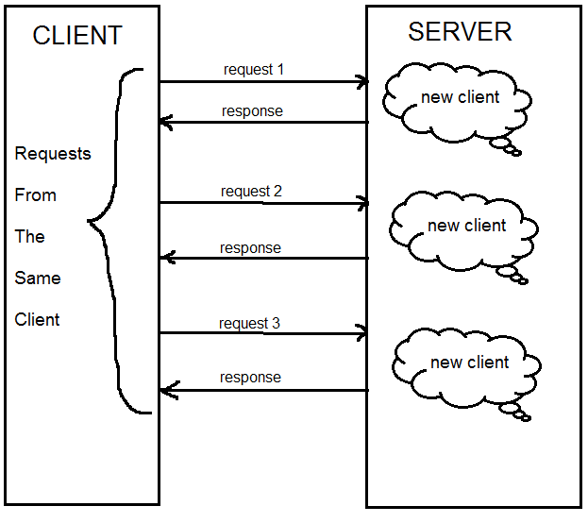
Session Tracking

Slide 6
What Is The Problem In Being Stateless ?
In most of the cases this stateless nature of http will not be a problem.
But there are certain scenario which require that the server should be able to identify the client and associate him with previous request.

Slide 7
Examples Where Session Tracking Is Used
In a shopping cart application a client keeps on adding items into his cart using multiple requests.
Whenever a request is made, the server should identify in which client's cart the item is to be added.
So in this scenario, there is a certain need for session tracking.

Slide 8
Examples Where Session Tracking Is Used
If a user has logged into his Bank Account and after successful login if he wishes to go to the Funds Transfer page then he would be required to login again as Funds Transfer would be a login-protected page and the Web Server doesn't have any built-in support for recognizing if the client requesting this page is the one who is already logged in or if it's coming from a new client.

Slide 9
So, What Is A Session ?
The term session means the time period the user has spent while navigating a website and if the site keeps track of all his activities then it is called session tracking.
Thus in short we can say the session tracking means creating a log of user activities.

Slide 10
How Django Supports Session Tracking ?
Django supports session tracking in 2 ways :
Cookies
Django’s Session Framework

Slide 11
Cookies
Cookies are small text files which a browser receives from the server embedded inside the response.
This is how cookies work in general:
The browser sends the request to the server.
The server sends the response along with one or more cookie to the browser.
The browser saves the cookie it received from the server. From now on, the browser will send this cookie to the server, every time a request is made to the server. The browser will keep sending the cookie to the server along with each request until the cookie expires.
When the cookie expires, it is removed from the browser.

Slide 12
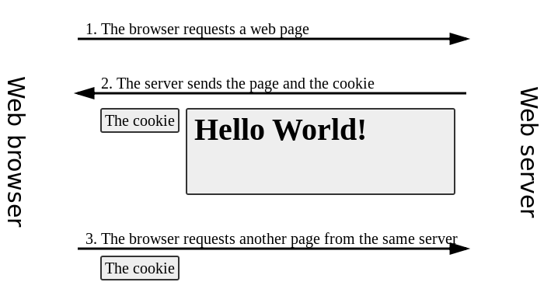
Cookies

Slide 13
Purpose Of Cookies
Cookies are mainly used for the following purposes .
For recording last login time.
User preferences for ex: sites like youtube use cookies to display a recommended list of videos as per the user’s previous video views.
An online shopping site can implement things like shopping carts and "quick checkout" options. The cookie contains an ID and lets the site keep track of you as you add different things to your cart. Each item you add to your shopping cart is stored in the site's database along with your ID value. When you check out, the site knows what is in your cart by retrieving all of your selections from the database. It would be impossible to implement a convenient shopping mechanism without cookies or something like them.

Slide 14
Creating Cookies In Django
We can create cookies using the set_cookie() method of the HttpResponse object.
Syntax: set_cookie(name, value, max_age=None)
name: name of the cookie
value: value you want to store in the cookie
max_age: age of the cookie in seconds. After that, it will expire. It is an optional argument, if not given then the cookie will exist until the browser is closed.

Slide 15
Reading Cookies In Django
In Django , the request object has a COOKIES attribute which acts like a dictionary.
We can use COOKIES to access a cookie value like this:
request.COOKIES['cookie_name']
request.COOKIES.get(‘cookie_name’)
request.COOKIES.get(‘cookie_name’,’default value’)

Slide 16
An Important Point
When we read cookie data, it will be returned as strings.
That means, even if we stored an integer value like 100 in a cookie, it will be returned as '100'.

Slide 17
Example
from django.shortcuts import render
from django.http import HttpResponse
def cookiedemo(request):
if not request.COOKIES.get('color'):
response = HttpResponse("Cookie Set")
response.set_cookie('color', 'blue')
return response
else:
return HttpResponse(f"Your favorite color is {request.COOKIES['color']}")

Slide 18
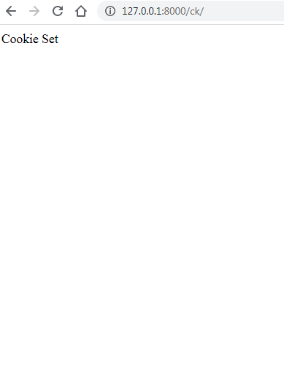
Output

Slide 19
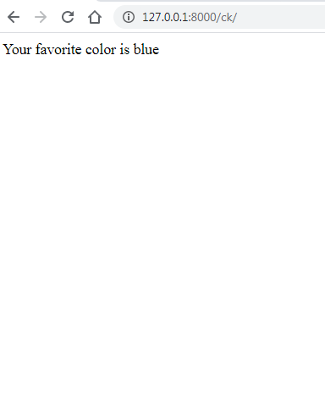
Output

Slide 20
Exercise
Develop an app that shows number of times the user has visited the site .
Also display the message ‘Welcome Newcomer’ for first time visitor and ‘Welcome back’ for returning users

Slide 21
views.py
from django.shortcuts import render
from django.http import HttpResponse
def visitcounter(request):
visits=request.COOKIES.get('visitcount')
if visits == None:
visits = 1
else:
visits = int(visits)+1
response = render(request,'visitcountapp/showvisitcount.html',{'visits':visits})
response.set_cookie('visitcount', str(visits))
return response

Slide 22
showvisitcount.html
<!DOCTYPE html>
<html lang="en">
<head>
<meta charset="UTF-8">
<meta name="viewport" content="width=device-width, initial-scale=1.0">
<title>Visit Counter</title>
</head>
<body>
<h2>Visit Counter</h2>
{% if visits == 1 %}
<h3>Welcome Newcomer!</h3>
<h4>Hope to see you again!</h4>
{% else %}
<h3>Welcome Back!</h3>
<h4>It seems you are enjoying surfing!</h4>
{% endif %}
<p>This is your visit no {{ visits }}</p>
</body>
</html>

Slide 23
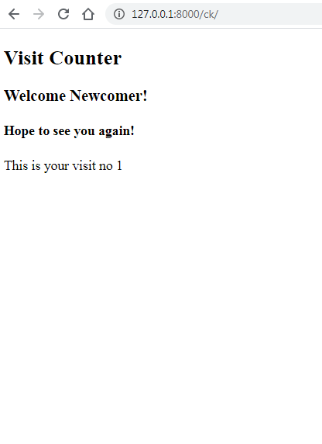
Output

Slide 24
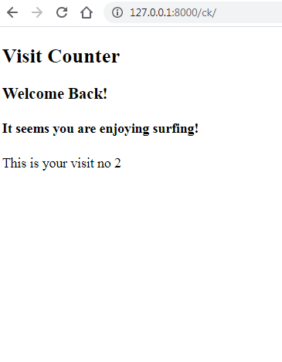
Output

Slide 25
Deleting Cookies In Django
Django provides us with easy methods for deleting cookies.
As we used set_cookie() to create cookies, we can also delete cookies using a similar function, called delete_cookie()
Syntax: response.delete_cookie(cookie_name)
The delete_cookie() takes in the name of the cookie to be deleted, and this method is associated with the response object.

Slide 26
Exercise
Modify the previous app so that it shows an option to the user to stop tracking
As soon as the user clicks it , the tracking should stop

Slide 27
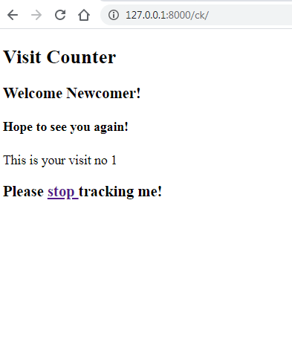
Output

Slide 28
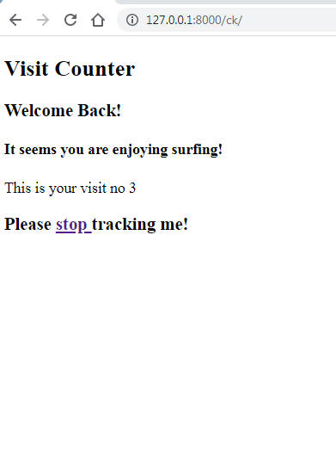
Output

Slide 29
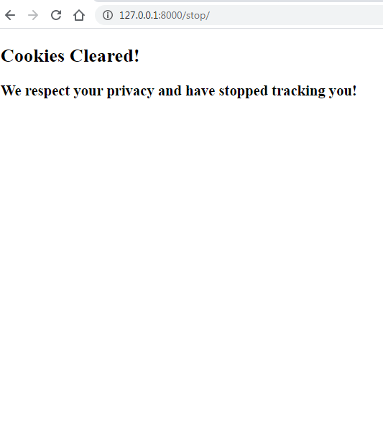
Output

Slide 30
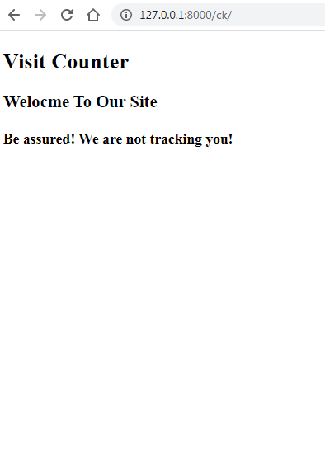
Output

Slide 31
views.py
from django.shortcuts import render
from django.http import HttpResponse
trackme=True
def visitcounter(request):
if trackme==True:
visits=request.COOKIES.get('visitcount')
if visits == None:
visits = 1
else:
visits = int(visits)+1
response = render(request,'visitcountapp/showvisitcount.html',{'visits':visits})
response.set_cookie('visitcount', str(visits))
else:
response = render(request,'visitcountapp/showvisitcount.html',{'visits':0})
return response

Slide 32
views.py
def stoptracking(request):
if request.COOKIES.get('visitcount'):
response = render(request, 'visitcountapp/stoptracking.html')
response.delete_cookie('visitcount')
global trackme
trackme = False
return response
else:
return HttpResponse('No cookie set')

Slide 33
stoptracking.html
<!DOCTYPE html>
<html lang="en">
<head>
<meta charset="UTF-8">
<meta name="viewport" content="width=device-width, initial-scale=1.0">
<title>Visit Counter</title>
</head>
<body>
<h2>Cookies Cleared!</h2>
<h3> We respect your privacy and have stopped tracking you!</h3>
</body>
</html>

Slide 34
showvisitcount.html
<!DOCTYPE html>
<html lang="en">
<head>
<meta charset="UTF-8">
<meta name="viewport" content="width=device-width, initial-scale=1.0">
<title>Visit Counter</title>
</head>
<body>
<h2>Visit Counter</h2>
{% if visits %}
{% if visits == 1 %}
<h3>Welcome Newcomer!</h3>
<h4>Hope to see you again!</h4>
{% else %}
<h3>Welcome Back!</h3>
<h4>It seems you are enjoying surfing!</h4>
{% endif %}
<p>This is your visit no {{ visits }}</p>
<h3> Please <a href='/stop'>stop </a> tracking me!</h3>

Slide 35
showvisitcount.html
{% else %}
<h3> Welcome To Our Site</h3>
<h4>Be assured! We are not tracking you!</h4>
{% endif %}
</body>
</html>

